Slide 1
CAP THEOREM
Morteza Ahmadi Nya

Slide 2
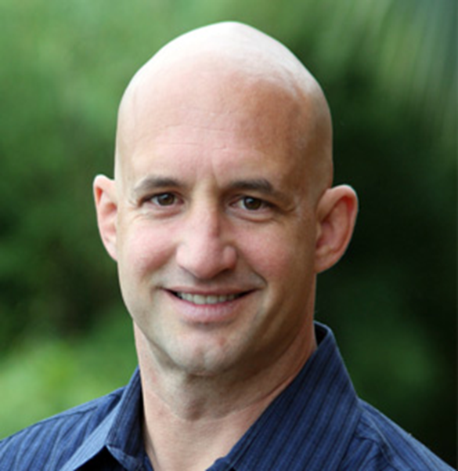
INTRODUCTION AND HISTORY
Proposed in the year 1998
Introduced at a distributed systems conference
BY Eric Brewer
CAP: stands for Consistency, Availability, and Partition Tolerance
Proven by MIT scientists in 2002

Slide 3
WHAT IS A DISTRIBUTED SYSTEM?
Collection of independent computers
These systems enable multiple machines to work together to achieve a common goal, sharing resources and …
Appear to the users of the system as a single system
Increasing Scalability
Increasing Reliability
Fault Tolerance

Slide 4
AND WHY THEY NEED CAP?
Complexity and Limitations: Helps designers to recognize the limitations.
Informed Decision-Making: Helps designers to make decisions for their system
Predicting System Behavior: In the face of issues, experts can predict the behavior of the system

Slide 5
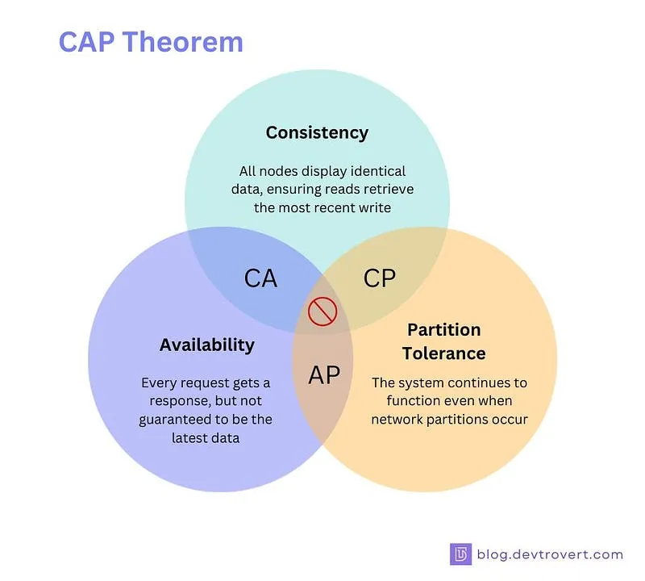
CAP COMPONENTS
Consistency
Availability
Partition Tolerance

Slide 6
Consistency and Partition Tolerance (CP)
Consistency: All nodes see the same data at the same time.
Partition Tolerance: The system can continue to operate despite network partitions.
Availability: The system might sacrifice availability during network partitions to maintain consistency.
Examples:
HBase
Google Spanner
MongoDB
Note: Systems with really important data use CP

Slide 7
Availability and Partition Tolerance (AP)
Availability: The system remains available for requests even if some nodes are down or there are network partitions.
Partition Tolerance: The system can handle network partitions and continue to function.
Consistency: The system might allow some inconsistency in the short term, but will eventually become consistent over time.
Examples:
Apache Cassandra
Amazon DynamoDB
Note: Most social networks use AP

Slide 8
Consistency and Availability (CA)
Consistency: All nodes in the system see the same data at the same time.
Availability: Every request receives a response, either success or failure.
Partition Tolerance: This model does not handle network partitions well.
Examples:
Single-node Databases
Note: I think it does not exists.

Slide 9
CONCLUSION

Slide 10
THANK YOU FOR YOUR TIME

